Slide 1

PowerShell on Linux: What’s the Big Deal?
>_
#!
Presented by:
Adam the Automator

Slide 2

Your Guide
Senior Automation Engineer
PowerShell Enthusiast
Pluralsight Author
Freelance Writer
adamtheautomator.com
Twitter: @adbertram
Microsoft Content/ Datacenter Management MVP

Slide 3

PowerShell is Available on Linux

Slide 4
What Does this Mean?
PowerShell is open source
You can make PowerShell better
Write one script for heterogeneous environments

Slide 5
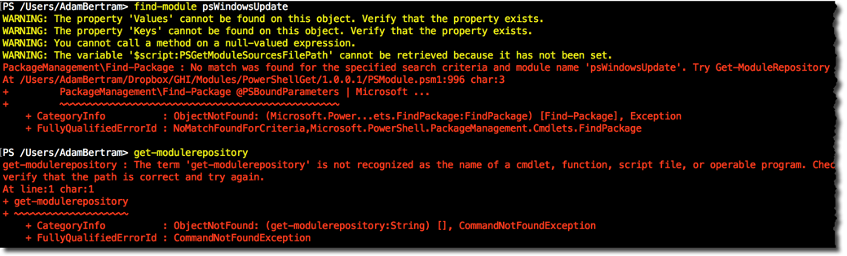
PowerShell on Linux is in Alpha
A lot of modules don’t work
Remoting
WSMAN not there yet
SSH might be the protocol
Lots of unexpected snafus

Slide 6

Keep your Pants On!

Slide 7


Who would want this anyway?
YES
NO
New sys admins that haven’t joined a cult yet
Windows admins that do occasional Linux work
Mac lovers that are forced to work on PCs
Pragmatic open source developers

Slide 8

Demo!

